Slide 1

Hackathon Project on UrbanLadder
TEAM NAME: FUTURE 5
TEAM MEMBERS:
DHARSHINI.T(851265)
HARSHANKUMAR.M(851190)
NAVANEETHAN.S(851228)
BALAJI(851207)
VELAMMAL.P(851254)
COACH: Ms. SUNDARA LAKSHMI
TRAINER: Mr. A.V.S. MURALI MOHAN

Slide 3
Mandatory Components Used

Slide 4
Multi-Browser Testing
Multi-browser testing is one of the important part of testing
This is because users of an application would expect it to work in all types of browsers.
Since the cilent would need the customer satisfaction for a successful business, multi-browser testing should be implemented

Slide 5
pom.xml
pom is an xml file which is contains the information about the project and the configuration details.
It contains the dependicies that are required for the build.
It requires the group_id, artifact_id, version, etc., inorder to incorporate the dependency into the project

Slide 6
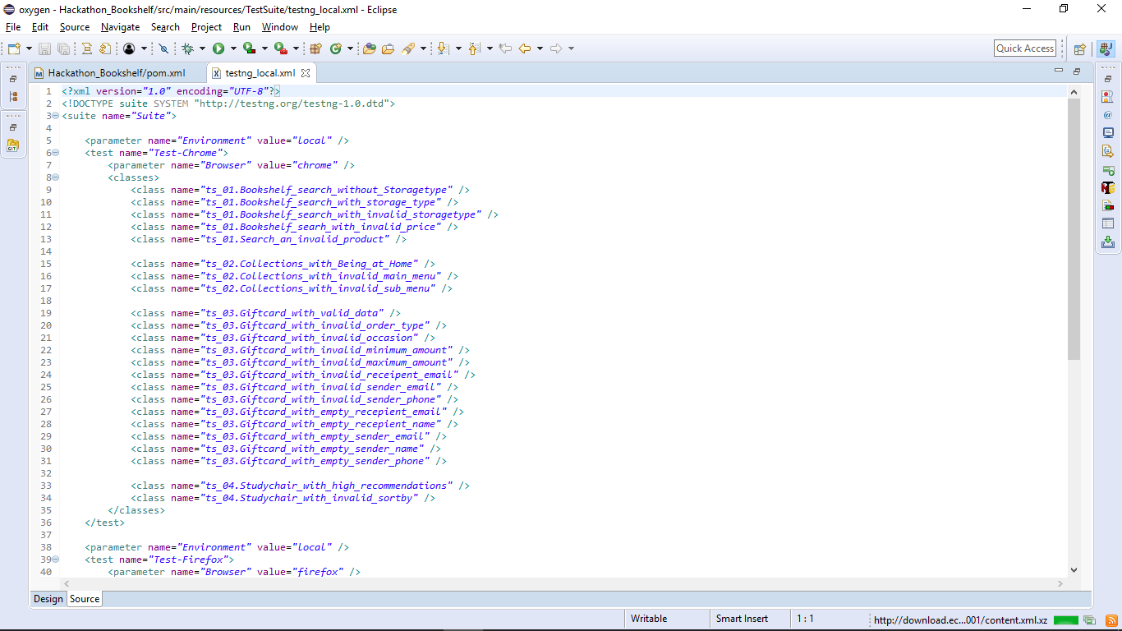
testng.xml
TestNG is a testing framework which is used to cover a wide range of test categories
It supporst
Annotations
Data-Driven testing
Multiple instances of same testing,etc.,

Slide 7
Data-Driven Framework
Data-Driven framework is used to drive the test case and suites from an external data feed
The data feed can be of following file types: xlxs, xls and csv.
It is a technique of seperating the data set from the test cases.

Slide 8
REPORT MAKEING
Report gives consolidated & updated information
Report as a means of internal communication
Report facilitates decision making and planning
Report discloses unknown information
Report gives Information to employees
Report gives reliable permanent information
Report gives information to shareholders
Report solves current problems

Slide 9
CLEAR CODE
Clearness
Best Practices
Logic Behind the Code
Maintenance
Easy to Test
Simplicity
Consistency
Cost Savings

Slide 10
ERROR/EXCEPTIONAL HANDLING
Separating Error Handling Code from "Regular“
Code
Propagating Errors Up the Call Stack
Grouping Error Types and Error Differentiation

Slide 11
Locator Selector Priority
Page object location plays a vital role in automation testing
Identifying the objects using locators and selector has been prioritizied into orders
The are: id, name, css, xpath and dom

Slide 12
FUNTIONAL LIBRARIES
These functions have gone through multiple rigorous testing and are easy to use.
The functions are optimized for performance
It saves considerable development time
The functions libraries are portable

Slide 13
SELENIUM GRID
Selenium Grid allows running multiple tests across different web browsers, operating systems, and machines.
This ensures compatibility of the application under
test across multiple combinations of web browsers,
operating system, and hardware architecture.
It speeds up the test suite completion time as it is
capable of running multiple tests in parallel.

Slide 14
The node is the one which does the work ordered by its master or the hub
The orders from the hub are excuted in the driver with which it was registered
And a node can run the commands from its master only if it has the corresponding driver in it
The hub is the master of all nodes
It instruct's the nodes to do a work
A particular hub creates a unique IP in which all the nodes are registered

Slide 16
Customizied Test Results
Used to examine the test
Helps to find the bugs
TestNG has two reporting formats
IRepoter
ITestListener

Slide 17
JENKINS
Code (Version Control System): Git
Build (Continuous Integration): Jenkins, Travis, TeamCity
Test (Continuous testing, inspection): JMeter, Sonarqube
Package (Artifact repository): Artifactory
Configure & Release ( Change management, containerization ): Docker Compose
Infrastructure ( Orchestration, cloud ): Docker Swarm, Kubernetes, Mesos, AWS, Gcloud, Nexus
Monitor ( Manage the performance): ELK, Grafana

Slide 18
Good to have components

Slide 19
Folder Structure

Slide 20
Naming conventions

Slide 21
Code Comments

Slide 22
Screenshots

Slide 23
Web-Page Syncronization

Slide 24
Wait Interface Usage

